Slide 1
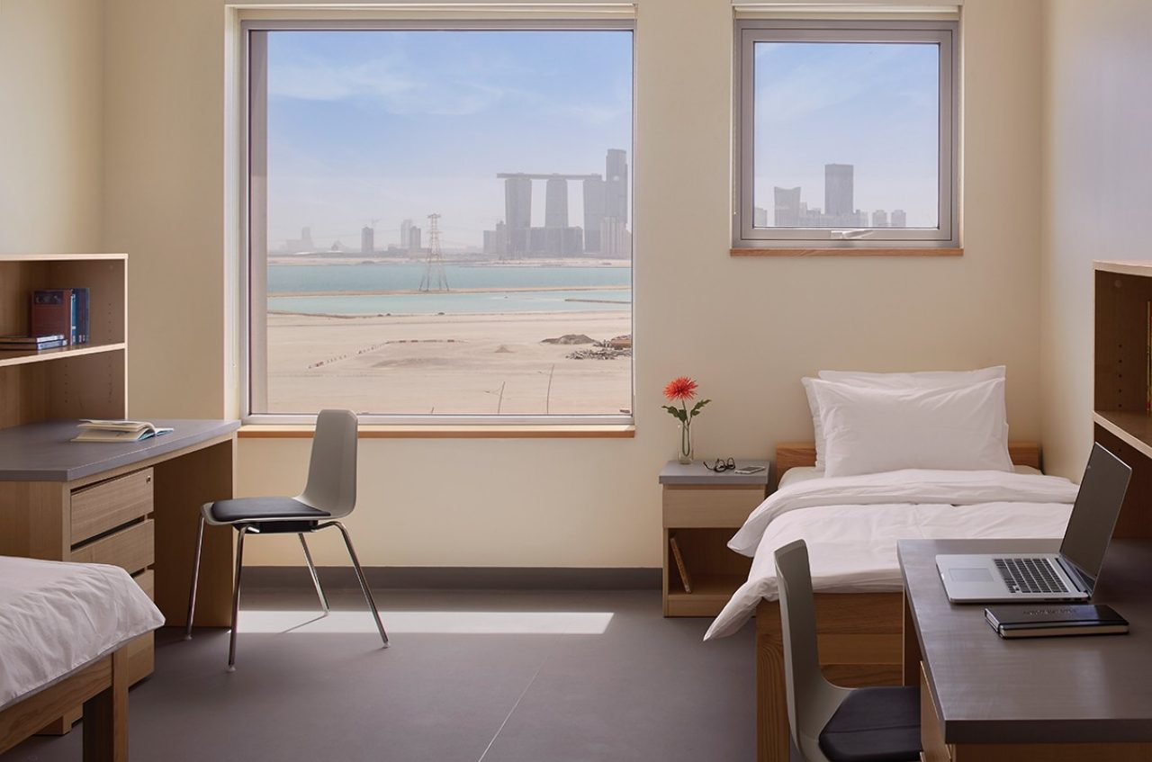

Room Manager
By Ruxandra Burian, Zichen Jing (Nancy), Jiwoo Lee, Afra Alhammadi, Renata Espinosa
by Ruxandra Burian, Zichen Jing (Nancy), Jiwoo Lee, Afra Alhammadi, Renata Espinosa

Slide 2
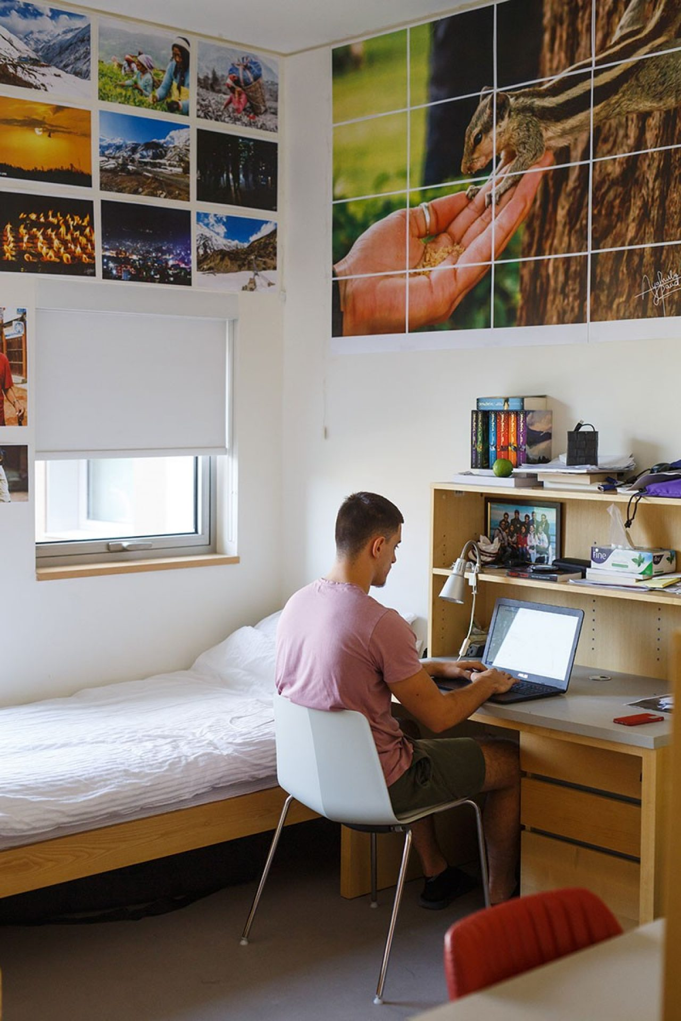
Problem Statement
Living alone with no bills might form the following habits:
Wasteful usage of energy
Living in an unhealthy environment

Slide 3


Primary Objective
To control the usage of air conditioner and light within dorms.
To encourage healthy consumption and prepare students for future living conditions.
Notes:
To achieve sustainability, we aim to control the usage of air conditioner and light within our dorms. Moreover, this will encourage healthy consumption and prepare students for future living conditions.

Slide 4
Walkthrough
Project detects room conditions using sensors. This happens continuously even before user prompts.
User wishes to track their energy usage/habitability of room.
When the set environmental conditions of the room have not been met for a determined period of time, the LED of the object will turn red.
The system provides data by uploading information to a website accessible to the user’s phone.
Notes:
Having no idea what’s happening in your room while you are out can be stressful.
You either want to check your room’s temperature or humidity, if someone is invading your private space, or perhaps if the room’s door is open.
The system will provide you with this data by uploading the information to a website accessible from your phone.
When the set environmental conditions of the room have not been met for a determine period of time the LED of the object will turn red to prompt the user to check the website.

Slide 5
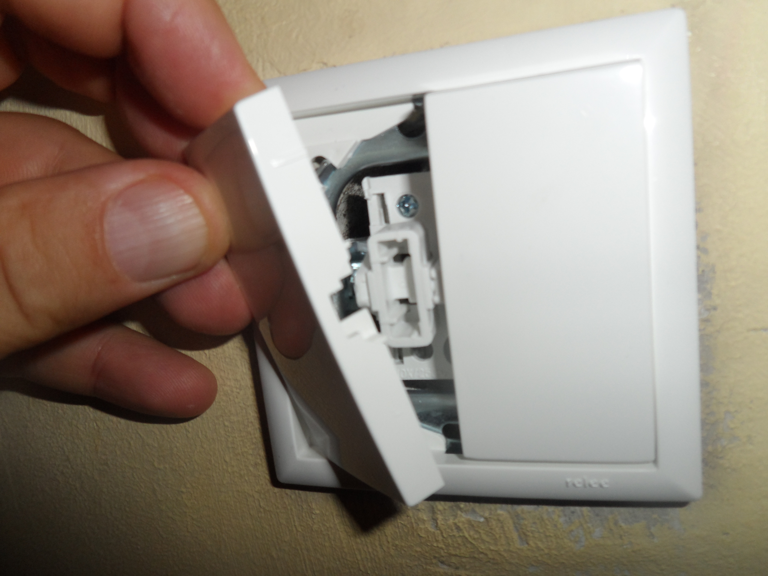
How will it work?
Using the accelerometer, we will monitor the position of the light switch in order to measure for how long a light has been on
Using the temperature sensor we will measure any drop in temperature that implies the usage of AC
Humidity sensor will serve the purpose of detecting the habitability of the room
Notes:
Sustainability is not about withholding resources, but using a reasonable amount that is good for the environment → acceptable “range”.

Slide 6
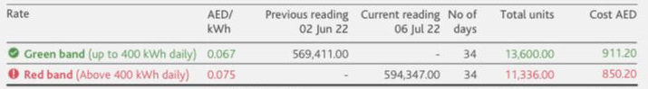
Electricity Price Check
United Arab Emirates, September 2022: The price of electricity is 0.079 U.S. Dollar per kWh for households
From actual house, the electricity bill is divided into green band (400 kWh daily) for 0.067AED/kWh and red band (above 400 kWh daily) 0.075AED/kWh
Overall, we assume the price for electricity in NYU Abu Dhabi to be 0.07AED/kWh

Slide 7

We are looking forward to your feedback!

